Slide 1
Lecture 02
Towards Decentralized P2P Currency

Slide 2
Do not distribute ...
These slides are not always prepared by me.
Most of the content comes from the reference book
  Bitcoin and Cryptocurrency Technologies: A Comprehensive Introduction
  Arvind Narayanan, Joseph Bonneau,
  Edward Felten, Andrew Miller, Steven Goldfeder
This lecture however builds upon and uses slides from CS 3700 Networks and Distributed Systems
  By David Choffnes available at https://david.choffnes.com/classes/cs3700fa17/

Slide 3
What is Currency?
Medium of exchange
  May or may not have intrinsic value (e.g. gold)
Store of value
  Allows one to store “value” rather than objects
  Facilitates lending, debt, investing, and other financial innovations
Notes:
What Is Intrinsic Value? Intrinsic value measures the value of an investment based on its cash flows. Where market value tells you the price other people are willing to pay for an asset, intrinsic value shows you the asset's value based on an analysis of its actual financial performance.
Types of money:
Commodity money
Representative money
Fiat money

Slide 4
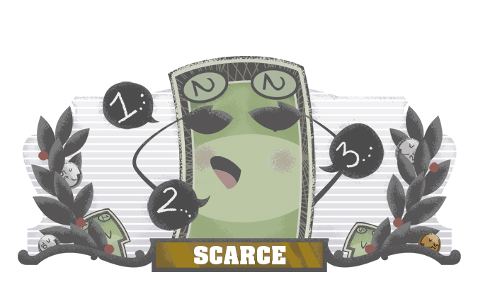
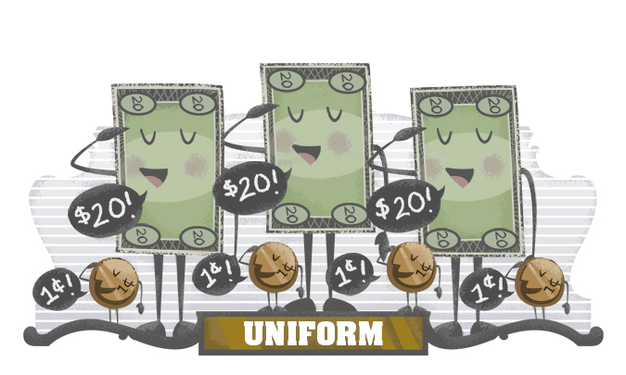
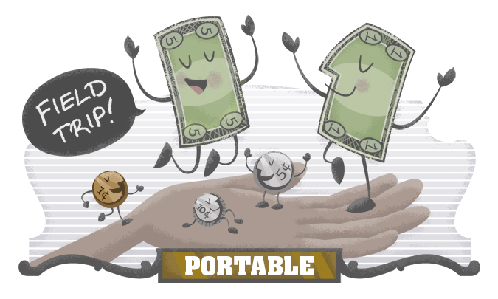
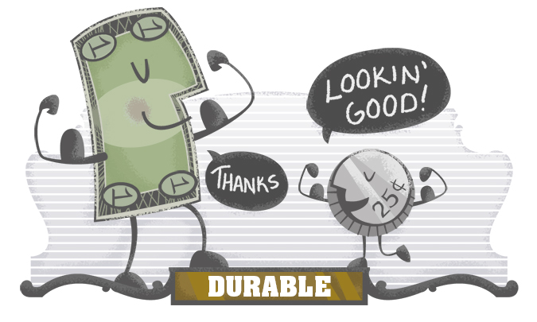
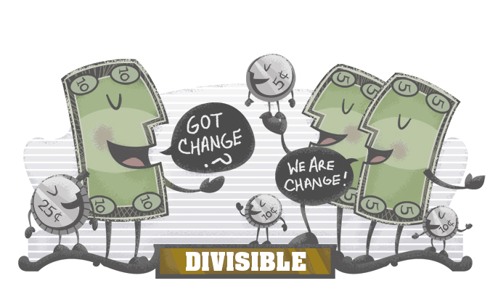
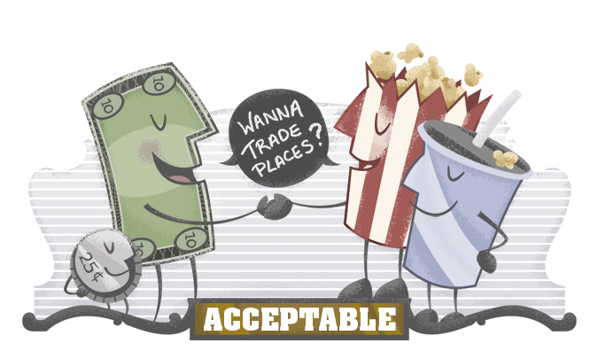
Is it money?
Notes:
Federal Reserve Bank of Dallas or the Federal Reserve System.
Most people think they would be better off if they had more money. But if we all were given more money, the only thing that would happen is the money would become less valuable. For money to retain its value, `it must be relatively scarce. Throughout history, this scarcity has been brought about through physical limitations, like the quantity of gold and silver that can be mined, or through planned limitations, like the volume of dollars that will be printed and put into circulation.

Slide 5
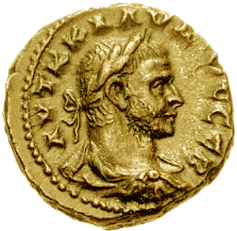
Physical Currency
Ancient coinage was based on precious metals
  Largely obviated the problem of counterfeiting
    A “fake” gold coin is still made of gold
  Lack of advanced mining techniques limited inflation

Slide 6
Physical Currency
Paper bearer tokens began to replace coinage around 600 BC
  Easier to carry, mint large denomination bills
  Paper was exchangeable for a commodity, e.g. the gold standard

Slide 7
Physical Currency
“U.S. dollars are not backed by anything other than the faith of the fools who accept it as payment and of other fools who agree in turn to accept it as payment from them. ”
Almost all of U.S. dollars, about 90 percent, are purely abstract — they literally do not exist in any tangible form.

Slide 8
Physical Currency
Modern physical currency is called fiat
  Not linked to a hard commodity, based on trust
  Why does fiat currency have “value”?
    Social contract – everyone accepts the currency, therefore it has value
    Centralized power – the government has the power to enforce taxation, and they accept currency to pay taxes

Slide 9
Physical Currency - Advantages
Easily portable
Cannot double-spend
  Spend the same piece of paper >1 times
Cannot repudiate payment
  Once you’ve given the paper, you can’t get it back

Slide 10
Physical Currency - Disadvantages
Easy to steal
Hard to monitor/tax transactions
Requires trust in the centralized issuing authority
Doesn’t work online

Slide 11
What About Electronic Currency?
Credit cards, Paypal, Online transfers
  Bank account store the amount of money held by each individual/company
  Transactions move money between parties
Advantages? Works online!
Disadvantages
  Requires trust in the issuing authority and third-parties
  Privacy, Transaction costs, centralized operations and control on transactions…

Slide 12
Towards Non-fiat Electronic Currency
Goal: e-cash without a centralized issuing authority
  Store and transfer value without a reliance on commodities or central banks
  Anyone can join the system and be party to transactions
Bitcoin was, arguably, the first viable non-fiat electronic currency

Slide 13
Why is P2P Currency Hard?
The most obvious challenge is determining ownership
  Who owns a given unit of currency?
Without strong ownership…
  Forgery – a user can mint arbitrary currency
  Double spending – how do you validate and enforce transactions?
  Theft – impossible to separate true and false claims about ownership
Rest of lecture: build up design of Bitcoin
  Let’s call our hypothetical currency neucoin

Slide 14
Requirements and Expectations
No centralized control
  Central banks, governments, police
No “strong identities”
  ID cards, passports
  Ideally, we would like anonymity (like physical paper cash)
Entirely electronic
  Not backed by commodities
Clear ownership of each neucoin
  Cannot generate money you don’t have
  Cannot double spend
  Cannot steal arbitrarily
  No repudiation

Slide 15




Motivating Example
I, Alice, transfer 1 neucoin to Bob.
Alice
Bob
1 neucoin
I, Alice, transfer 1 neucoin to Charlie.
1 neucoin
I, Alice, transfer 1 neucoin to Mallory.
Mallory
Charlie
1 neucoin
1 neucoin
Can transactions be forged? Can neucoins be stolen? Can users double spend?
Notes:
Yes
Yes
Yes

Slide 16


Introducing Cryptography
Alice
S_{a}
S_{b}
Bob
P_{a}
P_{b}
Each entity in neucoin is defined by a public/private keypair
  Knowledge of private key gives ownership of neucoins
Coins are transferred from one public key to another public key

Slide 17


Signed by Alice’s Private Key
P_{a} transfers 1 neucoin to P_{b}
Alice
S_{a}
S_{a}
S_{b}
Bob
1 neucoin
1 neucoin
P_{a}
P_{a} transfers 1 neucoin to P_{c}
P_{b}
S_{a}
Mallory
S_{m}
P_{a} transfers 1 neucoin to P_{m}
S_{c}
Charlie
S_{m}
1 neucoin
P_{m}
P_{c}
Can transactions be forged? Can neucoins be stolen? Can users double spend?

Slide 18
Preventing Forgery
How do we prevent users from minting arbitrary neucoins?
Add a trusted third-party that issues serial numbers
  Also known as a bank
  Let’s assume bank is trusted, and has a well-known public key
10238
26671
00392
B
B
B

Slide 19

P_{a} transfers to P_{b}
10238
Alice
S_{a}
S_{a}
S_{b}
Bob
B
10238
10238
P_{a}
P_{a} transfers to P_{c}
P_{b}
B
B
10238
B
S_{a}
Mallory
S_{m}
S_{c}
Charlie
10238
P_{m}
P_{c}
B
Can transactions be forged? Can neucoins be stolen? Can users double spend?

Slide 20
Preventing Double Spending
What if the trusted bank also tracked who owns each neucoin?
  Bank would have a ledger, serve as official record of ownership
  Charlie can contact the bank, verify that Alice owns a given coin
Problems?
  Centralized ledger totally defeats the purpose of neucoin

Slide 21
Preventing Double Spending
Instead, the network is the bank
  Participants in neucoin collectively keep track of all transactions
  Known as the public ledger
  To verify that Alice isn’t double spending, Charlie can check the public ledger

Slide 22



Is the signature in this transaction valid?
Does P_{a} own 10238?
P_{a} transfers 10238 to P_{b}
P_{a} transfers 10238 to P_{c}
Alice
S_{a}
S_{a}
S_{a}
10238
P_{a}
Public Ledger
Bob
S_{b}
P_{a} owns 10238
10238
10238 from P_{a} to P_{b}
P_{b}
Charlie
S_{c}
P_{c}
neucoin Network

Slide 23
Bitcoin at a High-Level
Bitcoin is a P2P network of nodes
  Each node keeps a log (ledger) of all Bitcoin transactions, ever
  This log is known as the blockchain
Transactions are broadcast to nodes in the P2P network
  Nodes validate transactions
    Correct signatures and correct ownership of coins
  Valid transactions are added to the blockchain and broadcast to other peers
  Transaction is considered accepted once it appears in the blockchain

Slide 24
Bitcoin at a High-Level
Ultimate goal: all transactions are known and agreed upon by the network
  In other words, we want global consensus of ordered events in log

Slide 25
Challenges
There are numerous aspects to consider
Let us consider following challenges for the time being
  How to defend against sybill attacks ?
  What is the incentive for users to keep blockchain consistent ?

Slide 26
Sybil Attack
P_{m} transfers 10238 to P_{b}
Classic attack that all P2P systems are vulnerable to
Mallory can introduce many fake nodes into the network
N/2 respond to Bob, N/2 respond to Charlie
Implication: one node = one vote doesn’t work
Mallory’s
Sybils
S_{m}
Mallory
S_{m}
P_{m} transfers 10238 to P_{c}
10238
S_{m}
P_{m}
Bob
S_{b}
10238
P_{b}
Charlie
S_{c}
10238
P_{c}
Notes:
A Sybil attack uses a single node to operate many active fake identities (or Sybil identities) simultaneously, within a peer-to-peer network. This type of attack aims to undermine the authority or power in a reputable system by gaining the majority of influence in the network.

Slide 27
Proof-of-Work
Need to tie voting to a resource that is hard to obtain
  In the past, we would have used a commodity (e.g. gold)
  Identity (e.g. passports) would work, but defeats the purpose
Key idea: tie voting to control of computational resources
  To add a transaction to the ledger, you must present a proof-of-work
  Proof-of-work can be generated by solving a cryptopuzzle

Slide 28
Proof-of-Work
Why is this a good idea?
  Cryptopuzzles prove that a node expended significant effort
  Obviates the need for Sybil prevention
    E.g. one machine pretending to be 100 Sybils doesn’t magically get 100 x CPU power

Slide 29
Proof-of-Work in Bitcoin
Key idea: a node can only add an entry to the blockchain if it solves a cryptopuzzle
  Other nodes can easily validate new blocks to ensure the puzzle has been solved
  Changes “one node/one vote” to “one CPU/one vote”
    To dominate the network, Mallory must control significant CPU resources

Slide 30
Proof-of-Work in Bitcoin
Implementing proof-of-work in Bitcoin
  Nodes receive transactions, group them into blocks
  Nodes attempt to solve a cryptopuzzle based on the previous block and the new block

Slide 31
Mining Blocks
Block Hash | Prev. Block Hash | Nonce Y
Transaction L
Transaction M
Transaction N
Block Hash | Prev. Block Hash | Nonce X
Transaction I
Transaction J
Transaction K
Block Hash | Prev. Block Hash | Nonce Z
Transaction F
Transaction G
Transaction H
Block hash = Hash(Prev Block Hash | Nonce X | <Transactions>)
Nonce X is the number chosen to make the block hash < target
  Changing the nonce changes the output of the hash function unpredictably
  All nodes are competing to identify a nonce that solves the puzzle
Creation of new blocks is known as mining

Slide 32
Building the Blockchain
At any given time, all nodes are searching for the next block
  Searching == trying different nonces to solve the puzzle
  Hoping to get lucky, identify nonce X such that block hash < target
Once a node discovers a block, it broadcasts it to other peers
  Other nodes validate (easy, simply recompute the hash)
  Nodes begin working on the next block (with the new block as Prev)

Slide 33
Incentive for Miners
  What is the incentive for users to act as Bitcoin nodes?
  Computing hashes is CPU intensive
  Bandwidth of communication with peers and users
  Storage cost of storing the entire blockchain

Slide 34
Creation of New Coins
Bitcoin solves the incentive problem in two ways
  Transactions may include a transaction fee
    Paid to whoever “wins” first, i.e. mines a block that includes the transaction
  New blocks mint new coins
    Node who wins “mines” a fixed amount of coins as a prize
      This is why it’s called mining
    Current reward is 6.25 BTC
    Called a coinbase transaction

Slide 35
Coinbase Transactions
Block Hash | Prev. Block Hash | Nonce X
Transaction I
Transaction J
Coinbase Transaction K
Elegantly solves several problems
  How are bitcoins minted?
  Who gets newly minted coins?
Reward for mining halves every 210,000 blocks
  Currently 6.25 BTC, was 50 BTC until 2012, 25 until 2016
  Will become 0 in year 2140; 21 million total bitcoins
  At this point, only transaction fees will incentivize miners

Slide 36
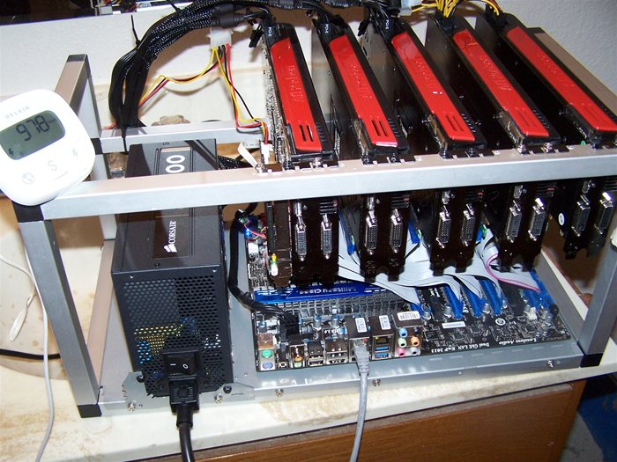
Mining
In theory, anyone can download bitcoin and start mining
  Your node will search for blocks
  But in practice, you will never win
Arms race: CPU < GPU < FPGA < ASICs
  Real miners use thousands of chips custom designed to solve cryptopuzzles
  Much faster and more power efficient than general purpose hardware
Many miners operate in Iceland (cheap power and free cooling)

Slide 37
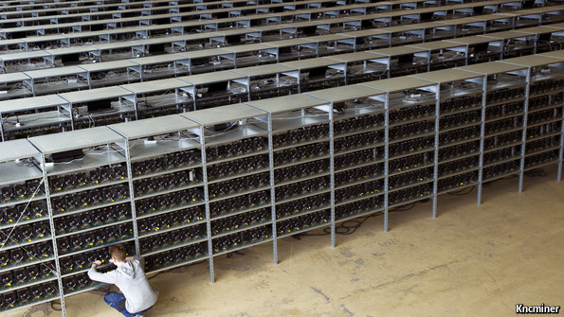
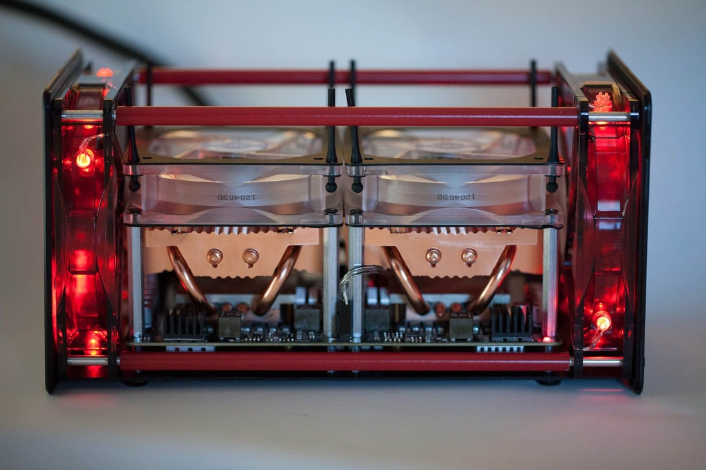

Slide 38
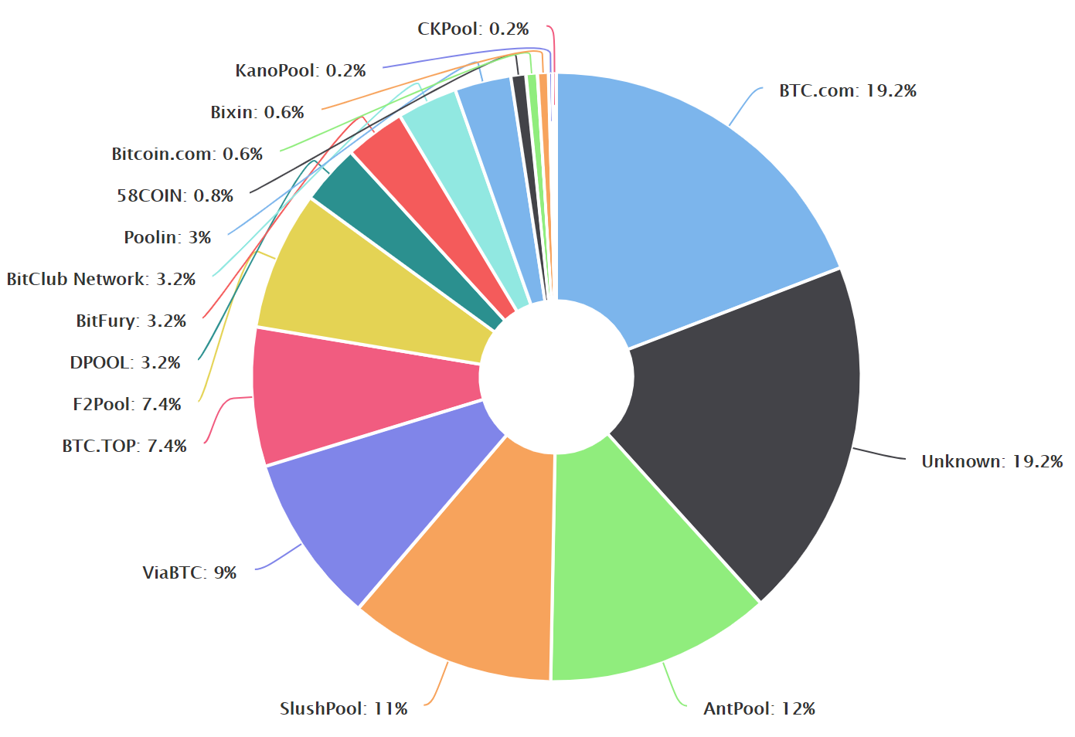
Mining Pools
Problem: Bitcoin is a lottery
  You are extremely unlikely to win
  Can we make it more “fair”?
    Nodes “get out” what they “put in”?
Solution: mining pools
  Groups of nodes that work together
  Split proceeds when any node finds the next block (more fair)
Lots of mining pools today
  Instances of pools with >25% of total hash power have existed

Slide 39
Is Bitcoin Secure?
Can I fake a transaction? (i.e. steal your bitcoins)
  No, you would need access to the victim’s private key
Can I edit the blockchain? (i.e. remove or modify old transactions)
  No, all blocks are linked by their hashes
  Changing historical block B_{t} would require changing all blocks [B_{t} , B_{current}]
Can I repudiate a transaction? (i.e. deny that I paid you)
  No, all of your transactions are signed by your private key
  Plus, you can’t go back and change previous blocks
Can I mint money out of thin air?
  Yes, but only through legitimately solving a cryptopuzzle (i.e. a coinbase txn)
  All peers can validate that your block (and the minted coins) are correct

Slide 40
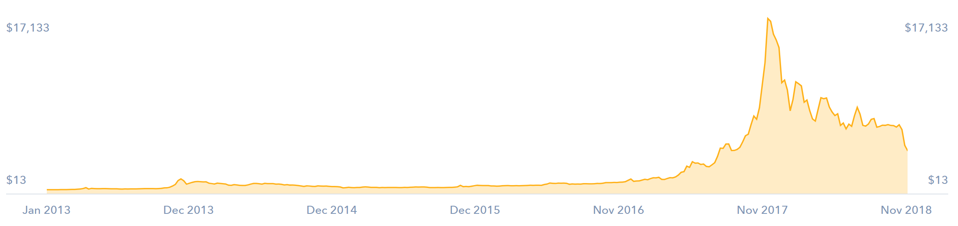
BTC to USD exchange rate has been very volatile over time
  All-time high: $65,000
  Current: around $26,117 (28-Aug-2023)
Several “bitcoin millionaires” exist
  Mined a bunch of coins back in 2009

Slide 41
Altcoins
P2P + cryptopuzzles + blockchain + incentives is a general formula
  Can be applied to other distributed systems problems besides currency
  Bitcoin is open-source
Led to the creation of dozens of alternate coins
  Litecoin – faster mining rate and scrypt instead of SHA-256 (harder to design ASICS)
  Filecoin – designed for storing files in the blockchain
  Namecoin – designed as a replacement for DNS
  Etherium – distributed virtual machine + smart contracts
Notes:
In cryptography, scrypt (pronounced "ess crypt") is a password-based key derivation function

Slide 42
Do not distribute ...
These slides are not always prepared by me.
Most of the content comes from the reference book
  Bitcoin and Cryptocurrency Technologies: A Comprehensive Introduction
  Arvind Narayanan, Joseph Bonneau,
  Edward Felten, Andrew Miller, Steven Goldfeder
This lecture however builds upon and uses slides from CS 3700 Networks and Distributed Systems
  By David Choffnes available at https://david.choffnes.com/classes/cs3700fa17/

